Slide 1
Workplace Survivor Syndrome
August 26, 2020
Lynn Dull, Lcsw
Larry Kammien, PhD
Applied Leadership

Slide 2
Agenda
Definition of workplace survivor syndrome
Understanding change
Identifying the feelings and behaviors of workplace survivor syndrome
Grief/Loss and survivor guilt
Five personalities of workplace survivor syndrome
Coping skills

Slide 3
Workplace survivor syndrome definition
“Workplace survivor syndrome,” is a term coined by organizational psychologists to describe the emotional, psychological and physical effects of employees who remain in the midst of company downsizing.

Slide 4
Is it real?
Multiple studies suggest that job cuts are just as hard on the people left behind as they are on those who were downsized.
One study showed an increase in alcohol consumption, smoking and workplace injury among layoff survivors.
Other studies report depression, plummeting productivity and poor morale among surviving staff.

Slide 5
Symptoms and outcomes
Survivor symptoms
Fear
Insecurity
Uncertainty
Frustration
Anger / Resentment
Unfairness
Betrayal
Distrust
Organizational outcomes
Decreased morale
Reduced motivation
Reduced engagement
Risk avoidance
Loss of productivity

Slide 6
Curve of Change
Pritchard and Associates and William Bridges
Vision
ENDING
NEW BEGINNING
Depth
Communication Needed:
“Inspirational”
3
1
Communication Needed:
“Information”
Duration
TRANSITION
2
Communication Needed:
“Supportive”

Slide 7
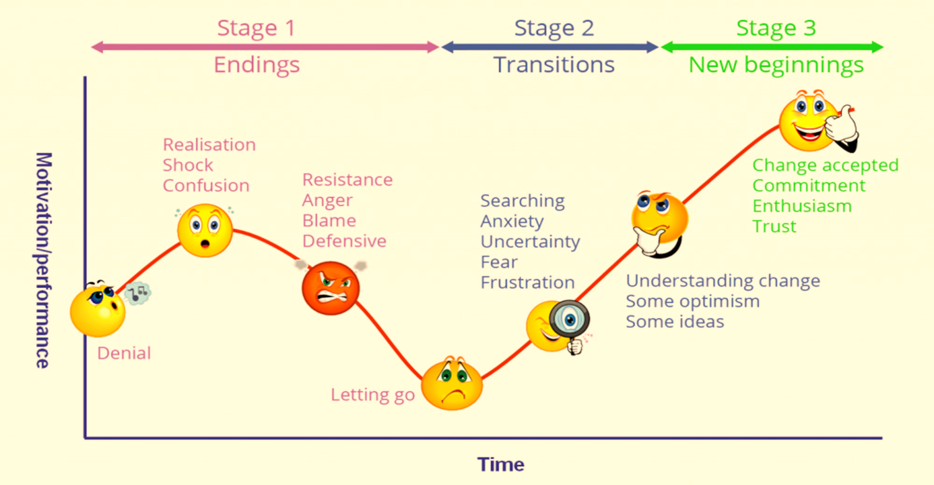
Ups and Downs of Change

Slide 8
A Word About Grief
Harvard Business Review ( March 23 , 2020) - The Discomfort You Are Feeling is Grief
Acknowledge it/ name it
Feeling more than one kind of grief
Grief is at both the micro level and macro level
Anticipatory grief can be unhealthy and lead to anxiety
Ambiguous grief/loss – normal due to shifting sands
  Confusing, disorienting and has a lack of closure

Slide 9
Alone: Lost Best Work Buddy
For employees who have lost their office best friend or "work spouse," the weeks and months following layoffs can be downright depressing
“Survivor's guilt,” a confused feeling of relief and grief
  Relief that they have not been laid off
  Grief for friends who have been laid off
  Feel undeserving of being spared, which leads to guilt
  May simultaneously feel happy that they have been spared, which leads to feeling guilty for feeling happy.
Psychologists describe this as a toxic mental state.
Notes:
For employees who have lost their office best friend or "work spouse," the weeks and months following layoffs can be downright depressing. They are suddenly isolated at a time when communicating their feelings about workplace turmoil is key to overcoming it. Often, they alienate themselves further by not forming alternative friendships out of fear that those too will soon come to an end.
These employees are also prime targets for feeling “survivor's guilt,” a confused feeling of relief and grief: relief that they have not been laid off and grief for friends who have been. They may feel undeserving of being spared, which leads to guilt. And they may simultaneously feel happy that they have been spared, which leads to feeling guilty for feeling happy. Psychologists describe it as a toxic mental state.

Slide 10
Time Wasting
Frozen: Anxious Time-Waster
  Overwhelmed with anxiety
  Fear they will be next , freeze up and can drive productivity level way down
The Time-Waster
  Works longer hours than before but gets less done
  Becomes invisible , hope they may be spared if layoffs hit again
  Do what they are told but have lost all commitment to the company
  Motivated less to do good work
  Disengagement is one of the leading after-effects of layoffs and leads to a workforce of the walking dead

Slide 11
Overdrive
In Overdrive: The Star Performer
  Driven by success and accomplishing goals.
  View layoffs as an opportunity to advance.
  Feel reaffirmed of their value to the company.
  Believe fewer colleagues means less competition.
  Feel anger and resentment if they are overloaded with work and don't feel fairly compensated.
  Experience poor management, frustration may build to a boiling point, causing them to reach for the escape hatch.

Slide 12
Panicked: Ready to Jump Ship
Consumed by worry, uncertainty and panic after layoffs
Look for other jobs or leave the company
Experts say the prolonged feelings of vulnerability leading up to and following layoffs can be more psychologically damaging than actually being laid off.
Long-lasting panic often leads employees to act out or seek an escape after work hours

Slide 13
Lost: Upended after losing a boss
Lost: Upended After Losing Boss
  Dazed and confused feelings can continue after a layoff
  The employee has lost trust in the company and the person trusted to guide their work
Feeling needy for direction and security
  Search for authority figure to latch on to.
  Find a false sense of security , listen to gossip

Slide 14
Coping Strategies
Remain calm. When layoffs hit, the immediate reaction of those left behind is often panic
Recognize that survivor guilt is normal
Be honest and efficient
Empower yourself
Manage your stress utilize additional coping strategies
Maintain perspective practice both and thinking
Experience a sense of mastery even in the small things that you are doing

Slide 15
Coping Strategies
Allow yourself time to grieve.
Find opportunity within adversity. What are you still doing well despite the stress? What new things have you discovered about yourself or your family?
Taking on additional work can be a stressor, take a mental break.
Cut yourself some slack, do your best each day,
Arrange physical distance between yourself and work, even for a day
Avoid office gossip about further cuts

Slide 16
Thank You

Slide 17
Manager Information to be sent out..

Slide 18
Curve of Change
John Kotter, Pritchard and Associates and William Bridges
Biz Case/ Urgency
Vision
Sponsorship
ENDING
NEW BEGINNING
Depth
Make Change Stick
Communication Needed:
“Inspirational”
1
3
Communication Needed:
“Information”
Don’t Let Up!
Duration
TRANSITION
Short Term Wins
Empower Action
2
Communication Needed:
“Supportive”

Slide 19
Scrambling: Managing a Downsized Team
Rule #1- take care of yourself
Layoffs can trigger roller-coaster emotions for the boss too.
Managers have lost many of their longtime colleagues and have had to let go of several valuable workers (an emotionally grueling task), they have to hold it together and project strength.
Managers/leaders are handling their own issues of loss and redistribution of work
Many shut down and are not communicating enough with their team.
Concern of the prospect of doing more with less,
Overwhelming need to fill the gaps by mis assigning or overloading remaining workers.

Slide 20
Leaders
Communicate thoroughly.
Be present, and be inclusive.
Engage employees on a personal level.
Exhibiting these behaviors may be difficult for leaders because if they’ve had to downsize,
they may be struggling
they may not feel they have time for the personal touch.
However, a breach in trust is like a disease that only gets worse with neglect. That means lower productivity, less innovation, more mistakes and potentially more turnover.
Trust can be destroyed more quickly than it can be rebuilt, so leaders should plan on committing to this process for the long haul. It’s more effective to engage in these actions consistently over a given period of time than to offer one or two grandiose gestures and leave it at that. To help change their behaviors, leaders might think about the people they trust personally. Those relationships likely aren’t based on heroic acts, but on countless positive interactions over time.
Notes:
A truncated email may not seem like a big deal, but it may not be interpreted well by someone fearing for his or her livelihood. Ambiguity breeds distrust, and clarity is the antidote. Think carefully before speaking, and consider how communications may lead to unintended interpretations. Listen to the team, and ensure they know they’ve been heard and understood.
If people feel involved in decision making, they feel empowered and in control, which can relieve stress and build trust. It’s equally important, however, for a leader to maintain a presence. Be sure to attend meetings, for instance. Failing to do so creates impressions of elusiveness, which is the antithesis of trust. Leaders also can effectively reinforce positive behaviors by delegating important tasks, which demonstrates as well as expresses trust.

Slide 21
Rebuilding Trust
A breach in trust is like an illness that only gets worse with neglect
That means lower productivity, less innovation, more mistakes and potentially more turnover.
Trust can be destroyed more quickly than it can be rebuilt,
Commit to a trust building process for the long haul. Rather than one or two grandiose gestures. It is more effective
To help change their behaviors, leaders might think about the people they trust personally. Those relationships likely aren’t based on heroic acts, but on countless positive interactions over time

Slide 22
Reactions to workforce reduction are highly individualized, as is the manner in which the process is handled. Typically, researchers and consultants have observed several key behavioral outcomes that are often experienced by survivors:

Slide 23
first step is becoming more aware of what we’re feeling at any given moment. That means cultivating the capacity to observe our emotions, rather than being run by them. Simply naming our feelings gives us more distance from them, especially when they’re intensely negative.
he second step is to calm yourself, regardless of what’s going on around you. A simple but powerful way is to use your breath. By breathing in through your nose to a count of three and out through your mouth to a count of six, it’s possible to clear your bloodstream of cortisol — the most pernicious stress hormone — in as little as one minute. Movement is also helpful. A burst of jumping jacks, or running up and down stairs, is a rapid, reliable way to discharge stress and quiet the body and mind.

Slide 24
Some organization are no affected significantly by Survivor Syndrome.
Possible reasons for this may be :
designing and implementing a downsizing program, and
included: awareness of the current economic climate — to what extent is downsizing a major part in current business trends, and how accepted is it as a business strategy tool?
fair and appropriate selection of those made redundant awareness of the level of managerial trust in the organization, both before and after downsizing processes conducted by strong leadership
values applied to employees who remain with the organization.

Slide 25
Experts say the prolonged feelings of vulnerability leading up to and following layoffs can be more psychologically damaging than actually being laid off.
Long-lasting panic often leads employees:
  to act out or seek an escape after work hours
  resulting in an increase of alcohol use, over-eating, sleep disorders and interpersonal problems

