Slide 1
WUSOM/BJH/SLCH GME Consortium Annual Program Evaluation (APE) Guide Academic Year (AY) 2022-2023

Slide 2
APE Overview
Purpose: To help programs lead conversations and documentation for the Program Evaluation Committee (PEC) and document progress to meet ACGME Common Program Requirements.
NEW – Word Fillable Document vs. PDF Filler Document: For more formatting flexibility, we transitioned from a PDF Fillable form to a Word Fillable form. The Word Fillable form provides a better format when working through the questions and printing of the document.
NEW - Qualtrics Tracking: For better tracking purposes, we will request the APE and respective APE documents be uploaded into Qualtrics - Link: AY2022-2023 APE Qualtrics Form.
NEW – Communication: We will request all communication be submitted to the GME Mailbox. This will enable the team to address questions, issues, etc. in a more timely matter in the event someone is out of the office. Email: gme@wustl.edu
NEW – Guide is PowerPoint vs. Word: The guide provided last year was transitioned from a Word Document to a PowerPoint. It is the same information provided in last year’s Word document, but hopefully outlines the information a little clearer.

Slide 3
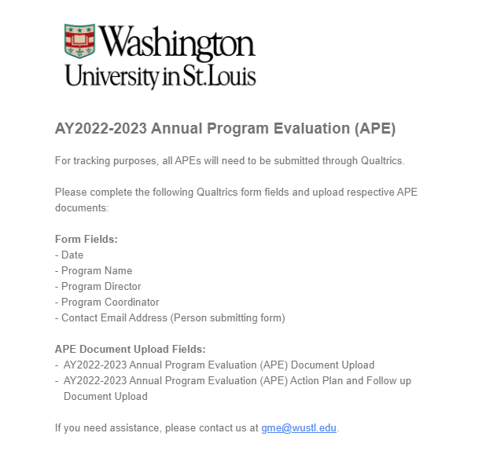
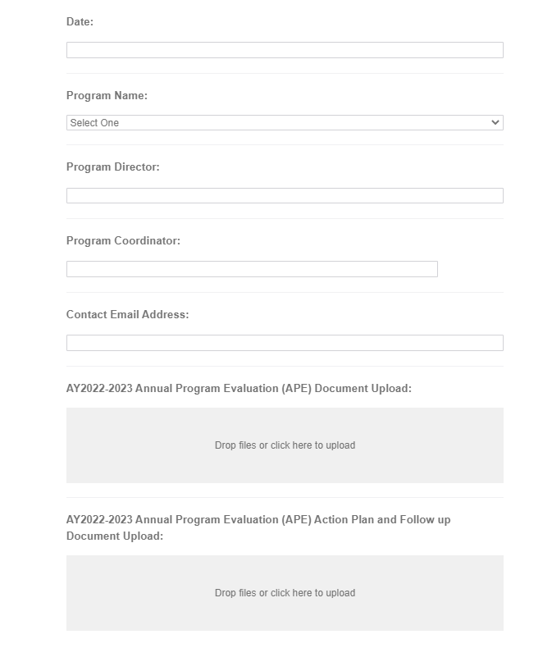
APE Qualtrics Tracking Form

Slide 4
APE Template Overview
Word form as outlined by the Accreditation Council for Graduate Medical Education (ACGME).
APE Template was reviewed and approved by the Educational Monitoring Subcommittee (EMS).
The APE will continue to be required by all ACGME Accredited programs along with their WebADS Annual Update.
Any areas on APE in need of improvement must be included in the APE Action Plan and Follow Up Template.
ACGME will continue to require approval by the Designated Institutional Official (DIO) prior to submission to the Review Committee (RC).
All links related to APE and its respective documents will be posted on the GME Website.
Some of the requirements referenced in the original APE template have been updated to direct you to current Common Program Requirements (CPRs).
Programs may also review their specialty-specific requirements for additional information expected by their respective Review Committee (RC).

Slide 5
APE and ADS Content – Helpful Hints
Program expected to utilize ADS data sources wherever applicable to complete APE template
Double dip with APE and ADS as much as is feasible for your program
Make the work count twice!
Additional ADS support resources to be provided

Slide 6
APE Q & A Guide – Program Evaluation Committee (PEC)
What is the purpose of the PEC discussion?
The purpose of the PEC discussion is to annually review your program aims to determine whether your program is achieving its aims. The PEC should review data to measure the success of the program in achieving its aims. Over time, the PEC may recommend changes to existing aims or new aims may need to be considered.
The PEC should review data collected by the program to measure its success. Surveys of graduates may be one way to determine whether graduates are going into careers that your program is targeting.
The PEC may also be able to identify other data sources that can be reviewed annually to measure the program’s success in meeting its aims. This date can be reported in your WebADS Annual Update to demonstrate to your RC whether your program is successful in meeting its aims.
If the PEC sees a need to edit the program aims, this language will likely become a part of the programs description to attract new applicants to your program, and should also be uploaded into WebADS to advise your RC of the programs future goals.

Slide 7
APE Q & A Guide – Action Items
What are some action items that might need to be added to the APE template?
Action items may include ideas the PEC members identified to measure the program’s success in the future.
Example: Some programs utilize a graduate survey to collect data on the types of careers graduates are obtaining after training. If work groups are developed as a result of the PEC discussion, this could also be included as an action item.
The PEC may charge a small group of members to edit the program description prior to your next recruitment seasons, or identify other aims to include in the program statement to meet changing needs in the specialty

Slide 8
APE Q & A Guide – Question 5
Summarize Program Aims
Please include your program aims (3-5 aims). The aims should align with the hospital and department aims.
They should be Specific, Measurable, Achievable, Realistic, and should have a Time frame.
Assign a number to each aim to make it easier to complete the Action Plan Tracking Form.
Question: Should our aim be our general program aims, or is this question similar to prior action items?
Your program aims can utilize language from your programs’ description on your webpage to attract new applicants in your specialty. You should also consider how your program may be different from others in the same specialty, or if your goal is to train graduates for specific careers. For example, is it your plan for graduates to become academicians, researchers, highly skilled in a unique area of medicine? This information should also be a part of your programs aims.
Your PEC should discuss whether other goals should be included in the programs aims. For example, is there a goal to increase diversity in the training, focus on healthcare disparities (locally or globally), or other areas of medicine you believe your program training achieves.
SAMPLE AIMS:
Produce excellent, independent practitioners who will be leaders in academic medicine.
Train individuals for expertise in population health and care of the medically underserved
Train residents to enter primary care practice

Slide 9
APE Q & A Guide – Question 9 - 13
The APE Template breaks out components of section V.C. of the Common Requirements as outcome parameters to ensure the PEC considers each area specifically during the PEC meeting.
Under each parameter is a list of resources that should be shared with the PEC members (if used by the training program) to address the parameter.
The PEC should use the APE template to outline whether resources are needed to meet any deficiencies listed in the parameter, or if the program is meeting its goals in the parameter.
Items included this section can be reassessed in future academic years to measure success and resolution of any identified concerns. Below are some examples of items that the PEC may discuss and document in the APE template.

Slide 10
APE Q & A Guide – Question 9: Evaluation Parameter 1
Program Evaluation Parameters and Results
Evaluation Parameter 1: Resident/Fellow Performance (V.C.1.c).(5) - V.C.1.c).(6).(d) ) - (Aggregate Data only- no individual data) and source(s)
of information.
(e.g.: Data sources include: Rotation evaluations, OSCEs, in-service examination, Case Logs, scholarly activity, CCC aggregate data, etc.)
Discussion items may include:
Did the PEC review overall evaluations of rotations? If a specific rotation was rated low or not valuable, what ideas for improvement was discussed by the PEC to address the feedback from house staff?
In-service exam: was there an area where several trainees scored lower than expected? Will the program incorporate more didactics, clinical exposure or other opportunities to bring up the overall performance? The PEC may recommend tracking in-training exam scores as a way to measure its improvement.
Case logs: Were minimum procedural volumes met as outlined by the RC (if applicable)? If this is an ongoing issue, how are you tracking and adjusting training to ensure minimums are met? You can include a summary of achievements for a series of academic years.
CCC aggregate data: Did the CCC identify issues that the PEC should consider. For example, are the evaluation tools providing enough data to assess for milestones? Are faculty returning enough evaluations feedback to assess trainee competence? Is faculty development needed to assist faculty in providing useful evaluation details or constructive criticism? What changes can be made to meet the CCC recommendations.

Slide 11
APE Q & A Guide – Question 9: Evaluation Parameter 2
Program Evaluation Parameters and Results
Evaluation Parameter 2: Faculty Development ( V.C.1.c).(5); V.C.1.c).(7).(b) ) and sources of information (e.g., formal and informal, online, departmental, institutional, and regional/national, as well as topics/content, any post-development assessment of enhanced skills, involvement on research, resident evaluations of faculty, leadership development programs relevant to role in program).
Discussion items may include:
Did the PEC consider any common themes from confidential faculty evaluations, learning environment issues, professionalism concerns, and other issues with faculty? If so, what recommendations were considered to address these issues?
Are faculty actively engaged in their own professional development? Is this an area for an opportunity to enhance faculty teaching, expectations for trainee feedback/assessments? The Academy of Educators Program might be a good resources to enhance faculty skills on teaching, providing assessments and/or improving leadership skills.

Slide 12
APE Q & A Guide – Question 9: Evaluation Parameter 3
Program Evaluation Parameters and Results
Evaluation Parameter 3: Graduate Performance (V.C.1.c).(6).(d) and sources of information (e.g., board examination performance, graduate placement, surveys of graduates and/or their employers or clinical settings).
Discussion items may include:
Is the program meeting Board pass rate requirements for first time takers? If not, what changes were discussed by the PEC to improve in this area?

Slide 13
APE Q & A Guide – Question 9: Evaluation Parameter 4
Evaluation Parameter 4: Program Quality (V.C.1.c) and sources of information (e.g., assessments of program by residents/fellows and faculty members-internal survey and ACGME surveys, recruitment, institutional data on performance, review of citations, areas of improvement and any program responses, review of curriculum and rotation to determine relevance, presence of a system of evaluation and final formal evaluation, Duty hour compliance). (GME Consortium goals for survey compliance = 90% for Duty hour questions <80% on all other survey questions)
Discussion items may include:
The sources of data included in program quality parameter are resources commonly used by programs to assess the program. For many years, GME has asked programs to respond to low survey compliance rates on the ACGME and Institutional Anonymous Surveys and respond to citations and Areas for Improvement (AFIs). Other resources the program collects to monitor the programs quality can also be included in the response to this parameter.
If a problem area is identified, programs should include a plan to address the issues as well as how you will monitor compliance to ensure resolution of the problem.

Slide 14
APE Q & A Guide – Question 10
Involvement in Patient Safety and Quality Improvement Initiatives
Please include a summary of the discussion describing trainee and faculty participation in:
Event reviews - If the program’s percent attendance is below the top quartile, provide a statement on how the program will increase their percent attendance
Education on how to report patient safety events - If the program’s error reporting index is below top quartile, provide a statement on how the program will increase their error reporting index.
Note: % attendance at debriefs, # of error reports and error reporting index are benchmarked using institutional data.

Slide 15
APE Q & A Guide – Question 10.1
Please comment on trainee and faculty participation on the following:
Instruction in the identification of healthcare disparities
Quality Improvement methods
QI projects
M&M
Education regarding hospital’s Quality Improvement goals
QI data shared with faculty and trainees about their patients and about the department as a whole
Any other Safety or Quality topics
Programs may set their own standard for attendance at the educational meetings above. The feedback will be used to determine how active faculty and trainees are in these educational activities.

Slide 16
APE Q & A Guide – Question 11
What program changes are being made in response to the Mayo Well-being Index and ACGME wellbeing data provided in the score card sent by GME?
If > 5 of your trainees participated in the Mayo WBI last fall, you would have received a report with your mean Mayo WBI scores and a comparison to your specialty mean WBI nationally. You also received data about the percent of trainees in your program with high distress scores (score > 5, which is associated with multiple adverse outcomes). If you did not receive a report, you did not have enough trainees participate in the Mayo WBI. If you are a smaller specialty training program, you may have received a report that grouped your trainees with other trainees (e.g. multiple IM specialties may have been grouped together). We ask that you look at this data and consider any programmatic changes that might help to improve trainee well-being.
If you are an ACGME accredited program, you also have access to your program’s ACGME well-being survey and to your specialty’s survey data. We ask that you look at this data and consider areas that may benefit from attention.

Slide 17
APE Q & A Guide – Question 12
Please comment on the following topics related to your current or planned Wellness initiatives:
Curriculum to address fatigue mitigation, burnout, mental health and suicidality, and substance abuse
Process for including trainee well-being in trainee assessments and goal setting
Mechanism for identifying trainees involved in adverse events for referral to clinician peer support
Process for monitoring workload and non-MD obligations and any planned changes to address challenges.
Presence of a mentoring or coaching program that addresses well-being
Programs can review the Best Practices Guide for Supporting Trainee Well-being for additional information on these topics. We are interested in learning what you already have in place and what you are planning to change related to these topics. Please feel free to share things that are working well so that we can share these practices with other program when appropriate.

Slide 18
APE Q & A Guide – Question 14
Action Plans for Areas for Improvement (V.C.1.d)):
Area for Improvement | Program Aim Number Associated with Item | Intervention/Initiative | Responsible Individual(s) and Resources | Follow-up/ Reassessment Method | Follow -up Date
Question: Question 14 seems to ask for the same information as Question 5 again – and I’m not sure how the two relate.
Would you be able to provide an example of a Program Aim and then response to Question 14?
This section should include any new or revised aims listed in question 5 above, as well as action items needing improvement in the other questions in the APE Template.
This section is intended to outline all areas that the PEC plans to work on during the academic year. The action items you include here can be kept with this year’s APE Template and should also be added to the Action Plan so you can track your progress over time.

